Slide 1
2024 LANDLORD BRIEFING FOR The Housing Choice Voucher (HCV) Program
Presented by Brazoria County Housing Authority
July 2024

Slide 2
Housekeeping
Restrooms down the hall on the right.
Questions: Ask anything any time. There is never a stupid question, just one that doesn’t get asked.
Any additional thoughts or questions can be submitted anytime to:
Jennifer Crainer, Assistant Director, (979) 864-1220
JenniferC@brazoriacountytx.gov
Stephanie Ebarra, Inspector, (979) 864-1961
StepanieE@brazoriacountytx.gov

Slide 3
Welcome and Thank You…
Thank you for your interest and for your participation in the Brazoria County Housing Choice Voucher Program
This program cannot work without you and your properties.
The goal of today’s presentation is to have you leave with more information than when you arrived, and that you will be excited to join or continue to participate with BCHA!

Slide 4
Agenda
Meet the BCHA Staff
What’s in Your Folder
Housing Choice Voucher Program Overview
New Program Requirements
Q&A

Slide 5
Meet the Staff
Daphne Lemelle, Director
Jennifer Crainer, Asst Director
Karen Land, Financial Coordinator
Toni Davis, Case Worker
Yvette Jammer, Case Worker
Kimberly Harding, Case Worker
Abby Morgan, Case Worker
Stephanie Ebarra, Inspector
Matt Summers, QC Inspector
Amanda Danford, QC Specialist
Kaitlynn Clay, Clerk
Belinda Roberson, Receptionist

Slide 6
What’s in your Folder
This Presentation
Request for Tenancy Approval (RTA)
HAP Contract and Tenancy Addendum
Housing Choice Voucher Fact Sheet & Program Myths
Payment Standards
Utility Allowances
Inspection Form (HQS and NSPIRE)
Chapter 9 - Carbon Monoxide
Chapter 11 – Smoke Detectors

Slide 7
Housing Choice Voucher Program Overview
Introduction
HCV Locally
Waiting List
Program Basics, Benefits, and Ways to Participate
Landlords are Key to Success
Program Roles
Rent to Landlord
HAP Contract & Lease
Tenancy Addendum
Inspections
Notes:
A lot to cover, we will go over high level and then get into a bit of details

Slide 8
Housing Choice Voucher (HCV) Program Introduction
HCV is the Federal Government’s major program for assisting low-income families, which may include elderly individuals or people with disabilities, to afford decent, safe and sanitary housing in the private market.
PHAs receive funding from the federal government to administer the HCV Program locally and help low-income families afford rent
Participant’s receive rental assistance from the PHA but find housing units in the rental market that meets their needs
BCHA provides rental assistance to over 600 households

Slide 9
HCV Waiting List
Those interested in participating in HUD’s HCV program apply through their local housing authority when their wait lists are open.
The Public Housing Authority (PHA) maintains a waiting list and offers vouchers as they become available.
Applicants must be low-income to be eligible.
Each PHA has the discretion to establish local preferences to reflect local needs and priorities.
When applicants are selected, they are interviewed to determine if they meet eligibility requirements.
Families who qualify for any local preference may be offered a voucher ahead of others that do not qualify for those particular preferences.
How does an individual or family receive assistance in the Housing Choice Voucher program?
Notes:
Could add your own local preferences to this slide instead of general information
Additional Options:
-Eligibility for a housing voucher is determined by the PHA based on the total annual gross income and family size and is limited to US citizens and specified categories of non-citizens who have eligible immigration status.
-In general, the family's income may not exceed 50% of the median income for the county or metropolitan area in which the family chooses to live.
-By law, a PHA must provide 75 percent of its voucher to applicants whose incomes do not exceed 30 percent of the area median income. Median income levels are published by HUD and vary by location. The PHA serving your community can provide you with the income limits for your area and family size.

Slide 10
HCV Benefits for Participants
HCV provides low-income families a rental subsidy
Voucher holders pay 30-40% of their monthly income towards rent
Voucher holders choose where they want to live
Voucher holders choose what type of property they want to rent
If a participant’s income decreases, their portion of rent will decrease while the rental subsidy increases, so the total contract rent remains the same
If a participant’s income increases to the point where the rental subsidy is zero, they can remain on the program for 180 days
Notes:
If you choose not to show the video, here are the points covered in the video
Voucher holders pay between 30-40% of their income towards rent which is defined as affordable
Choose where they want to live within the PHA jurisdiction which covers “x”. Quick explanation of portability.
Choose what type of property they want to rent with some limitations
When income decreases, so does their rental portion. The subsidy increases to make up the balance of the rent to landlord. This increases housing stability
Families can remain on the program for 6 months after they begin paying full rent, this helps encourage families to pursue employment and professional development/growth because this won't result in them losing their subsidy immediately?

Slide 11
HCV Benefits for Landlords
Landlords of all types can benefit from participating in the HCV Program
Timely payments - The PHA sends the subsidy payment directly to the landlord every single month. BCHA offers Direct Deposit if interested.
Screening - Apply the same screening criteria as you would for any other applicant. BCHA screens tenants based on their Admin Plan and screening criteria.
Regular inspections – These can help identify maintenance needs early on, although Landlords may initially see inspections and subsequent repairs as a burden to program participation. Regular inspections facilitate the longevity of your investment, cost avoidance by identifying potentially expensive problems down the road.
Notes:
If you choose not to show the video, here are the points covered in the video
This includes landlords with duplexes, triplexes, large apartment complexes, single family homes, landlords with units in town, in the suburb and in rural areas
Without private market landlords, the HCV program could not be successful

Slide 12
Benefits for the Housing Authority
More Landlords means HCV tenants have more choices to find a suitable unit in Brazoria County.
The Housing Choice Voucher Program is successful because of the partnerships we make with landlords. We focus on customer service and effective partnerships, so we listen to your needs and make adjustments where we can.
By offering your units for rent, allows families to find suitable units and BCHA to assist those families with a place to call home.

Slide 13
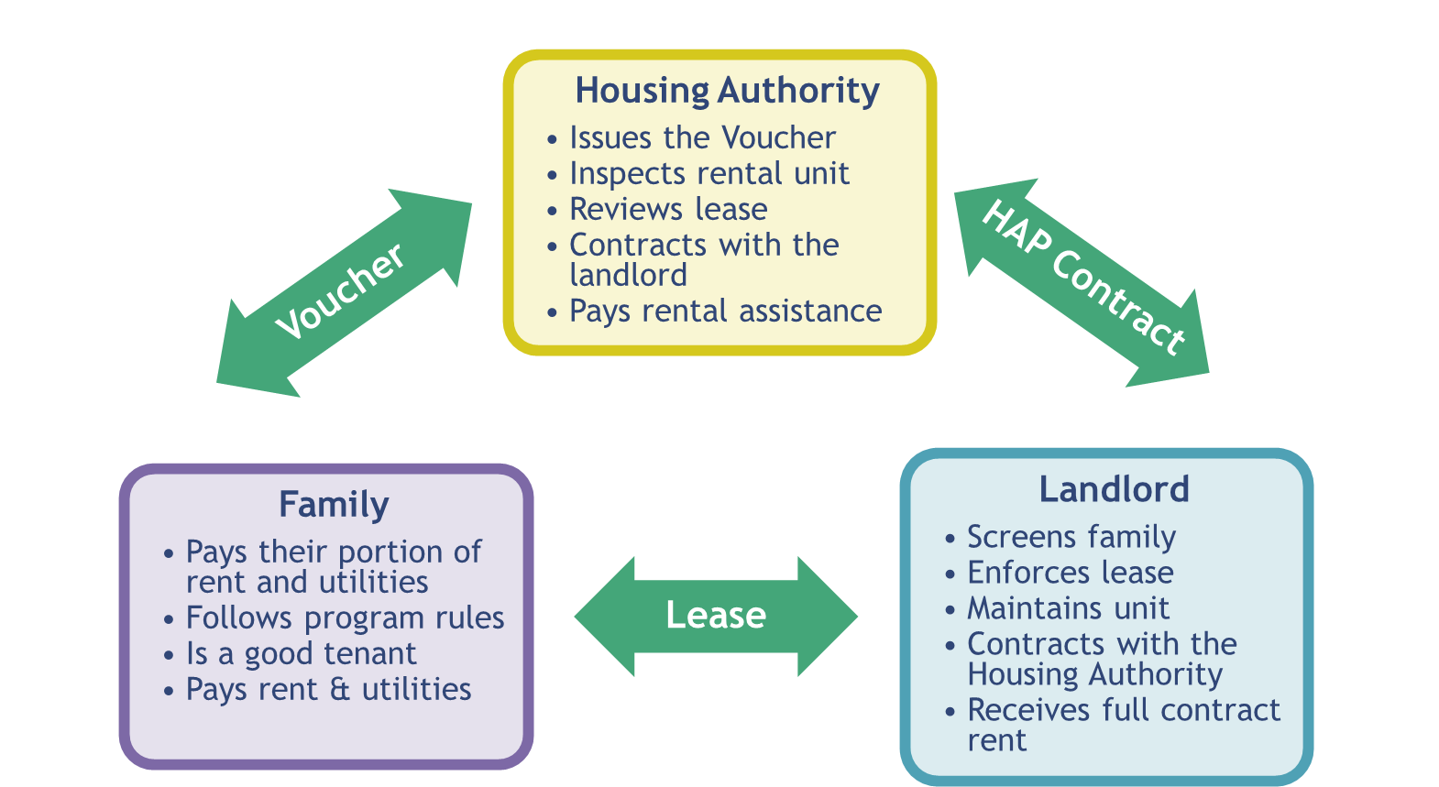
HCV Program: Roles
Notes:
Landlord receives full contract rent = family rent portion + rental subsidy

Slide 14
What is a Voucher?
A voucher is a written contract between the Housing Authority and a family describing program requirements and confirms family’s eligibility for rental assistance
Vouchers expire after 120 days if a family does not find a suitable unit
Lists the bedroom size the PHA has determined suits their family composition and subsidy standard
Can be adjusted in size if the family’s household composition changes

Slide 15
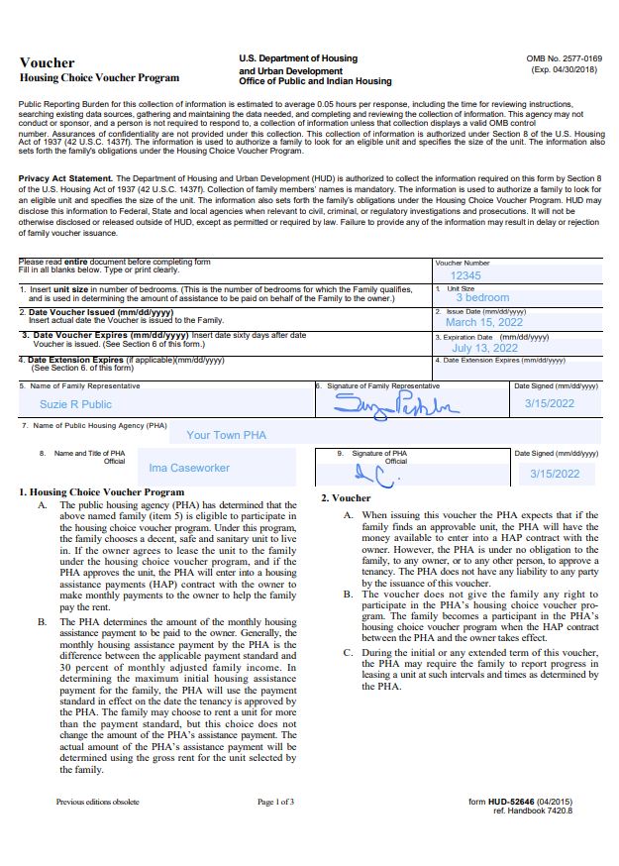
Sample Voucher

Slide 16
Owner Do’s
Do keep the unit compliant with HQS standards. Owners with a history of renting units that fail to meet local housing codes or inspections may be removed from the program.
Do enforce your lease. Send lease violations to the tenant and housing office at BCHA@brazoriacountytx.gov.
Do collect rent and charge late fees. Notify BCHA if the tenant is not paying their portion.
Do send in rental increase requests no less than 60 days of the effective date or changes in the utilities.
Do sign the RTA after the family passes any compliance or background checks the landlord requires.
Notes:
The Housing Authority must approve the rent amount
Consideration is given for tenant paid utilities.
Programmatic factors that go into the approval:
Voucher Payment Standards (VPS) are set that represent the amount generally needed to rent a moderately-priced dwelling unit. This is a baseline for how the Housing Authority calculates the subsidy amount.
Affordability: The VPS does not limit the amount of rent a landlord may charge or the family may pay. However, the amount of subsidy plus 40% of a family’s income is the maximum amount for rent plus utilities.
Rent Reasonableness is an amount of rent that is determined based on comparable units on the rental market

Slide 17
Owner Don’ts
Don’t rent to relatives. BCHA must not execute a HAP contract when the owner of the unit is a relative of the assisted family, unless approved by BCHA. Prohibited relationships include parent, child, grandparent, grandchild, or sister/brother of the assisted family.
Don’t discriminate against any tenant. Landlords must not violate the Fair Housing Act or other federal equal opportunity requirements including but not limited to Title VI of the Civil Rights Act, Section 504 of the Rehabilitation Act, or the American with Disabilities Act.
Don’t threaten the right to peaceful enjoyment of the premises by the family, or threaten a BCHA employee.
Don’t sign the RTA if you have not approved the tenant to lease your property.

Slide 18
Voucher lease-up process

Slide 19
Sample Request for Tenancy Approval

Slide 20
Leasing a Unit
Family selects a unit, completes RTA paperwork with landlord (Request for Tenancy Approval)
PHA reviews RTA, determines if the rent is reasonable and affordable for the family
PHA inspects the rental unit using HUD established Housing Quality Standards
The standards set a minimum criteria for the health and safety of program participants
Family & landlord sign a lease, PHA & landlord sign a HAP Contract
Family moves in and pays their portion of the rent, PHA pays subsidy to landlord
Notes:
The Housing Authority must approve the rent amount
Consideration is given for tenant paid utilities.
Programmatic factors that go into the approval:
Voucher Payment Standards (VPS) are set that represent the amount generally needed to rent a moderately-priced dwelling unit. This is a baseline for how the Housing Authority calculates the subsidy amount.
Affordability: The VPS does not limit the amount of rent a landlord may charge or the family may pay. However, the amount of subsidy plus 40% of a family’s income is the maximum amount for rent plus utilities.
Rent Reasonableness is an amount of rent that is determined based on comparable units on the rental market

Slide 21
HAP Contract
The Housing Assistance Payments Contract is an agreement between the Landlord and the Housing Authority. Key details of the lease are reflected in the HAP Contract.

Slide 22
HAP Contract and Landlord Lease
Housing Assistance Payment (HAP) Contract between the PHA and landlord
May not be modified
Governs housing assistance payment
Includes required tenancy addendum
Must be signed within 60-days of move-in
Landlord Lease between tenant and landlord
Enforced by landlord
Tenancy addendum becomes part of landlord lease

Slide 23
The HAP contract terminates when one of the following occurs:
The owner or the tenant terminates the lease;
The PHA terminates the HAP Contract in accordance with HUD requirements (i.e. PHA Terminates the family, Mutual agreement, abatement process, etc.);
The family moves from the unit;
The death of a single member household, including single members with a live-in aide;
Tenants income has increased to a point there is no HAP portion and 180 have elapsed. This is also referred to as Zero HAP. If the families situation changes during the 180 days, then the assistance to the family shall resume.
A mutual agreement is when the owner and tenant mutually agree to terminate the lease on a specific date not less than 30 days.

Slide 24
BCHA has the discretion to terminate the HAP Contract in each of the following situations:
It is it determined that available program funding is not sufficient to support continued assistance for families in the program;
The unit does not meet the size requirements due to change in family composition;
The assisted family breaks up and the family member leaving the assisted units is entitled to retain the voucher;
The unit does not meet Inspection Standards;
Owner’s breach of the HAP contract.
If the owner has commenced the process to evict the tenant, and the family continues to reside in the unit, the PHA must continue to make HAP payments until the owner has obtain a court judgement or other process allowed the owner to evict the tenant. BCHA will stop payments on the 5th day of the court awarded possession. However, if the family moves from the unit prior to going to court, BCHA will consider this abandoning the unit and will recoup the remaining amount for the month the tenant vacated.

Slide 25
Payment to Owner
BCHA must make HAP payments to the owner in accordance with the terms of the HAP contract, and the owner must comply with the provisions of the HAP contract in order to receive such payments.
BCHA strives to process payments on the first of the month unless it falls on a weekend or holiday. Payments are only processed on the first of the month. Direct Deposit is available so that payments are not delayed by the mail service or holidays.
BCHA will notify the owner and tenant of any changes in the housing assistance payment and the effective date of such change.
BCHA will only begin payments once a HAP Contract and lease have been received.
The part of the rent to the owner that the tenant pays shall not be more than the difference between the rent to owner and the housing assistance payment. The landlord cannot demand or accept any rent payment from the tenant in excess of their portion, nor demand they pay late fees on the housing assistance payment.

Slide 26
Limit of PHA Responsibility
The PHA is only responsible for making housing assistance payments to the owner in accordance with the HAP contract and HUD requirements for a tenancy under the voucher program
BCHA shall not pay any portion of the rent to owner in excess of the housing assistance payment. BCHA shall not pay any other claim by the owner against the family.
If BCHA has determined that the owner is not entitled to the housing assistance payment or any part of it, BCHA, in addition to other remedies, may deduct the amount of the overpayment from any amounts due the owner.

Slide 27
Owner Certification Key Points
During the term of the HAP Contract the owner certifies:
The rent to owner does not exceed rents charged for comparable unassisted units;
Except for the rent to owner, the owner has not received and will not receive any payments or other consideration (from the family, the PHA, HUD, or any other public or private source) for rental of the contract unit during the HAP contract term;
The owner is not the parent, child, grandparent, grandchild, sister, or brother of any member of the family, unless approved by the PHA.
Will not discriminate against any person because of race, color, religion, sex (including orientation and gender identity) national origin, age, familial status, or disability in connection with the HAP Contract.
Compliance with the Violence Against Women Act, as amended, and HUD’s implementing regulation at 24 CFR part 5, Subpart L. and program regulations. Page 10 of the Tenancy Addendum goes into greater detail.

Slide 28
PHA & HUD Access to Records
Per the HAP contract (Pg.7 #11):
The owner must provide any information pertinent to the HAP contract that the PHA or HUD may reasonably require. (This may include rent rolls)
The PHA, HUD and the Comptroller General of the United States shall have full and free access to the contract unit and the premises, and to all accounts and other records of the owner that are relevant to the HAP contract, including the right to examine or audit the records and to make copies.
The owner must grant such access to computerized or other electronic records, and to any computers, equipment or facilities containing such records, and must provide any information or assistance needed to access the records.

Slide 29
What Triggers a New HAP and Lease
24 CFR 982.305(c)(2) states that a PHA must execute a new HAP Contract and lease in the following cases:
If there are changes in the lease requirements governing tenant or owner responsibility for utilities or appliances;
If there are changes in lease provisions governing the term of the lease;
When the family moves to a new unit, even if the new unit is in the same building or complex; and

Slide 30
Rental Increases & Changes to the Utilities
All rental increases and utility changes MUST be submitted to BCHA and the tenant no less than 60 days before the rental amount goes into effect.
Email renewal notifications to BCHA@brazoriacountytx.gov
If renewal notifications are not received timely, the new rental amount will not be effective until 60 days after the renewal is received.
All rental increases require a new lease to be signed. Payments will be held until a new lease is received by BCHA.
Rental increases are subject to rent reasonableness requirements.
Any changes in the utilities must be reported and a new RTA and HAP contract must be completed.

Slide 31
Owner/Management Changes
Report all changes in Management or Ownership as soon as possible in order to prevent interruption of the HAP payment.
This will help facilitate the proper Owner/Management Company is paid the rent timely.
Income documents at the end of the year are correct.
Not all changes in Management will require new documentation.
Notes:
Add and local, state or national policy updates

Slide 32
Tenancy Addendum
The Tenancy Addendum is a standard HUD form that is attached to the Lease between the Landlord and the Tenant which details the program rules.

Slide 33
Key Points
The tenant shall have the right to enforce the tenancy addendum against the owner. If there is any conflict between the tenancy addendum and any other provisions of the lease, the language of the tenancy addendum shall control.
Composition of the household must be approved by BCHA. The family must report any birth, adoption, or court-awarded custody of a child. Other members may not be added to the lease without the approval of BCHA.
Changes in the rent to owner shall be determined by the provisions of the lease. HOWEVER, the owner may not raise the rent during the initial term of the lease.
The tenant is not responsible for the Housing Authority’s portion. Failure to pay the housing assistance payment is not a violation of the lease. The owner may not terminate the tenancy for nonpayment of the PHA housing assistance payment nor charge the tenant late fees on the Housing Authority’s portion.
Owner must maintain the unit and premises in accordance with Housing Quality Standards.
Owner may terminate the tenancy in accordance with the lease or good cause, and give a 90 day notice to the tenant.

Slide 34
Inspections
An Inspector will conduct an Inspection to ensure that HUD inspection standards are met. All housing units with HCV Tenants must meet the following thirteen (13) HQS Performance requirements*
Sanitary facilities
Food Preparation and refuse disposal
Space and security
Thermal Environment
Illumination and electricity
Structure and materials
Interior air quality
Water Supply
Lead-based pain
Site and neighborhood
Sanitary Conditions
Smoke detectors
*HUD is currently piloting new inspection standards called NSPIRE. The NSPIRE model prioritizes health, safety and functional defects over appearance. When implemented, these standards would be used beginning October 1, 2025.
Notes:
What are the benefits
Inspections play an important role in the HCV program. Inspections are required by law and take place before and periodically throughout tenancy.
Landlords may initially see inspections and subsequent repairs as a burden to program participation, there are benefits to regular inspections to the longevity of their investment, cost avoidance by identifying potentially expensive problems down the road, etc.
Landlords want to know that inspection requirements and execution are carried out consistently and scheduling and completion of inspections are efficiently facilitated.

Slide 35
Inspection Protocols
New Units –
BCHA will not schedule an inspection until the tenant has passed all compliance review.
The inspection will be scheduled per the RTA’s “date unit ready for inspection”. If the unit fails, BCHA will NOT schedule a follow-up inspection. It is up to the landlord to call for a re-inspections
Unit must pass within 30 days or 3 inspections.
Tenant cannot move-in until the first of the following month of the passed inspection.

Slide 36
Inspection Protocols – con’t
Annual Inspections –
BCHA schedules the annual inspection for approx. 10 months from the previous initial inspection date*.
If the unit fails, BCHA will schedule the re-inspection for 2 weeks.
We will only schedule the 2nd inspection. Any subsequent inspections the landlord must email when repairs are completed.
*Note - If a tenant is zero HAP, yes, they are still a participant and the unit must be inspected.
It is up to the owner/landlord to determine if the repairs will be completed by the re-inspection date or call and cancel the inspection for a later time.
If there are delays in getting parts to complete the repair, a request for an extension must be made prior to the unit going into abatement.

Slide 37
Work Orders & Abatements
Work orders will not be accepted for Life-threatening or health and safety issues.
Work orders must be signed by the tenant and maintenance or management
Must have photos of completed repair attached to the work order
A unit will go into abatement if the repairs have not been completed within the 30-day timeframe
Tenant is not responsible for the abated payment amount
Landlord must email once the repairs have been completed
Once notified, inspections will be scheduled at the next available time slot

Slide 38
Quality Control Inspections
HUD requirement
Random sample from previous inspections.
5 for the first 50, then one for every 50 after that. Generally 6-7 inspections per month.
Helps all inspectors by discussing any discrepancies in failed items.
Keeps inspection failed items uniform across all inspectors

Slide 39
Damage Move-out
Once a tenant vacates the unit and returns the keys, the landlord may inspect the unit for damages above ordinary wear and tear. If damages remain, the process to report the damages is as follows:
List all damages, the cost to repair, and remaining charges left unpaid (remotes, mail keys, utilities, etc.) minus any Security Deposit.
Email the list of damages and the total due to BCHA.
An Inspector will schedule an inspection and inspect only the items that are listed on your move-out request. Do not repair any of the damages until the inspection is completed. If repairs have been completed, BCHA cannot verify the damage was caused by the family.
Once the inspection is completed, the damages and associated costs will be reviewed for reasonable and customary. Some of the costs will be adjusted.
A letter explaining the inspection and costs due will be mailed to the tenant giving them 30 days to make payment or dispute the charges.

Slide 40
If the tenant fails to make payment within 30 days, they may lose their voucher assistance. BCHA may extend this time frame.
What does this mean for the owner?
BCHA can assist in recouping some of the costs for repairs by holding the family accountable for their actions or failure to act;
Owners have the option to either enter into a repayment agreement with the family or require the full sum within the 30 day time frame;
Reduce costs in referring families to collections and potentially never recouping the repair costs.
There may still be an outstanding costs associated with the damages. We respectfully request that the tenant is not turned over to collections until the 30 days has lapsed. This gives the tenant time to pay for the damages BCHA feels is reasonable and customary, and less cost on the owner for the collection agency charges. After the 30 days, you may still turn any remaining balance over to collections.

Slide 41
What’s New
Smoke Detectors
Carbon Monoxide detectors
*NSPIRE – effective October 1, 2025
Landlord Listing
Additional resources
With NSPIRE, HUD will accept public comments every 3 years. So some of these standards may change or be modified.
Notes:
Add information

Slide 42
Smoke Detectors
HUD requires smoke detectors be installed in the following locations:
In each sleeping area
Outside each sleeping area (i.e. Hallway, dining area, etc.)
On each level of the sleeping unit, including basements.
This action is intended to align the smoke alarm requirements with industry standards, increase the safety of tenants, and reduce the risk of losing affordable housing units due to smoke and fire damage as a result of outdated or inoperable devices.
The President also signed the Consolidated Appropriation Act of 2023, which incorporated The Public and Federally Assisted Housing Fire Safety Act of 2022, that each unit and common use area of federally assisted housing contain hardwired or 10-year non-rechargeable, sealed, tamper-resistant battery-powered smoke alarm devices effective December 2024.
Hard-wired detectors are interconnected in such a manner that the activation of one alarm will activate all of the alarms in the individual unit.

Slide 43
Carbon Monoxide Detectors/Alarms
HUD has required all units with a fuel burning appliance or an enclosed garage to have a Carbon Monoxide detector/alarm installed that meets the 2018 International Fire Code, Chapters 9 and 11.
The inspectable areas that we will be looking at will include:
Flues on gas water heaters are properly installed and functional;
Ensure gas appliances are working properly;
Gas space heaters are vented properly.
We request landlords help facilitate in resident education, particularly during natural disasters or during periods of electrical outages, especially if the tenant has never been exposed to gas appliances.
Notes:
Add any policy changes or proposed policy changes

Slide 44
Chapter 9 - Section 915.1.2 through 915.1.6 of the 2018 IFC states the conditions and 915.2 specifies the locations of carbon monoxide alarms. Alarms shall be outside each separate sleeping area or, if the fuel burning appliance is located within a bedroom or attached bathroom, the alarm shall be placed in the bedroom.
Alarms shall be hard-wired with a battery back-up.
Combination carbon monoxide/smoke detectors are an acceptable alternative.
Alarms shall be maintained and subsequently replaced when they begin end-of-life signals. Useful life is generally 10 years.
Exception:
battery operated detectors/alarms are permitted where the code that was in effect at the time of construction, did not require carbon monoxide detectors be provided.

Slide 45
NSPIRE
National Standards for the Physical Inspection of Real Estate is changing the landscape of inspections. NSPIRE is changing from a room to room inspection to a component inspection in 3 inspectable areas.
No longer are we looking at the unit and common areas, but we are now inspecting the Inside, Outside, and the Unit.
Egress from the unit Fencing and Parking Areas
Building & Address Signage Common Laundry Facilities
Refuse and Disposal Areas Mold-Like Substances

Slide 46
Resident owned property is not evaluated as an obstruction to fire escape access
Fire doors must function properly and not be locked.
Double-keyed deadbolts are not allowed
Fencing must be secure and gates must be operational
Parking areas must not have any pot holes or ponding water
Trash around the site grounds and large discarded items
Site signage, property address, and building numbers must be visible and not damaged or missing
Most mold-like substances have a 30-day fail rating unless severe

Slide 47
Landlord Listing
BCHA is transitioning from a paper landlord listing to an online site. We will begin partnering with Affordablehousing.com as an online rental property listing site. This is a free online housing locator to help tenants find housing and landlords fill vacancies. BCHA will refer tenants to this website to locate a suitable unit.
Landlords will be able to set up an account so that they can:
List available units, square footage, rental amount, security deposit, pictures, amenities, etc.
Click to update the listing when your unit becomes unavailable, so that you are not getting unwanted calls from prospective tenants. When the unit is available, then quickly update the listing.
Update the rental or deposit amounts, pictures, etc. at any time.
Look for changes on our website!!

Slide 48
Brazoria County Housing Authority’s website https://www.brazoriacountytx.gov/departments/housing-and-urban-development/housing/landlords
or
https://www.affordablehousing.com/list-your-property/

Slide 49
Where to learn more
HUD’s Landlord Page:
https://www.hud.gov/program_offices/public_indian_housing/programs/hcv/landlord
HUD Exchange Landlord Page:
https://www.hudexchange.info/programs/public-housing/hcv-landlord-resources/
Housing Choice Voucher Fact Sheet:
https://files.hudexchange.info/resources/documents/PIH-HCV-Landlord-Fact-Sheet.pdf

Slide 50
Additional Resources
NSPIRE Standards – Inspectable areas
https://www.hud.gov/program_offices/public_indian_housing/reac/nspire/standards
NSPIRE Standards – How to Inspect Video Series
https://www.hudexchange.info/programs/public-housing/nspire-standards-how-to-inspect/
The full 2018 IFC Code, as well as Chapter 9 and Chapter 11 regarding CO alarms or detectors
https://codes.iccsafe.org/content/IFC2018
https://codes.iccsafe.org/content/IFC2018/chapter-9-fire-protection-and-life-safety-systems
https://codes.iccsafe.org/content/IFC2018/chapter-11-construction-requirements-for-existing-building

Slide 51
Brazoria County Housing Authority Housing Choice Voucher (HCV) Q & A
More questions?
Jennifer Crainer
(979) 864-1220
JenniferC@brazoriacountytx.gov

Slide 52
Housing Authority Contacts
Stephanie Ebarra, Housing Inspector
(979) 864-1961 Sebarra@brazoriacountytx.gov
Matt Summers, Quality Control Inspector
(979) 864-1953 Msummers@brazoriacountytx.gov
Jennifer Crainer, Asst Director
(979) 864-1220 JenniferC@brazoriacountytx.gov
Daphne Lemelle, Director
(979) 864-1860 DaphneL@brazoriacountytx.gov
General email – BCHA@brazoriacountytx.gov

Slide 53
Thank you for joining us today!
More questions?
Jennifer Crainer
(979) 8694-1220
JenniferC@brazoriacountytx.gov

